Slide 1
Security Analysis Tools
Information Security

Slide 2
Security Analysis Tools
Security Analysis Tools
Footprinting and Fingerprinting
Types of Analysis Tools

Slide 3
Security Analysis Tools
Types of Analysis Tools: Packet Analyzers
Wireshark
  Tcpdump is the packet analyzer, used before Ethereal (Wireshark)
  Wireshark is a fantastic open source network protocol analyzer for Unix and Windows.
  It allows you to examine data from a live network

Slide 4
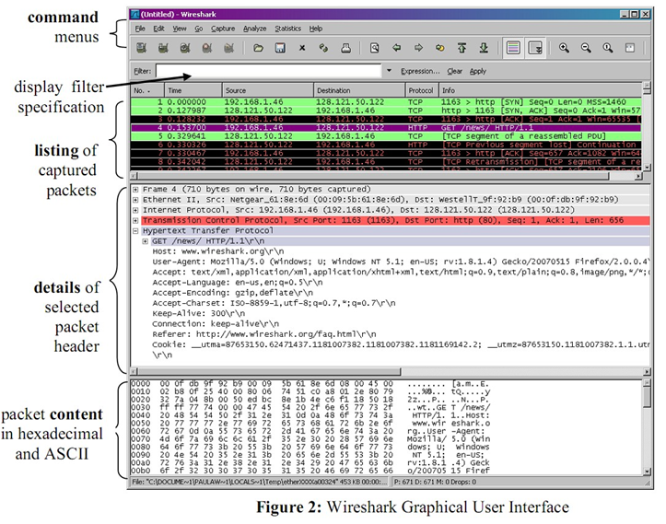
Security Analysis Tools

Slide 5
Security Analysis Tools
Types of Analysis Tools: Packet Analyzers
A network analyzer captures all the traffic that is going across the network and displays it in readable format.
Network analyzers typically are used to:
  Troubleshoot problems on the network
  Detect and identify malicious software
  Capture and decode data on a network
  Analyze the operations of applications
  Generate and display statistics about the network activity

Slide 6
Security Analysis Tools
Types of Analysis Tools: Content Filters
A software program or a hardware/software appliance that allows administrators to restrict content that comes in to a network
Example
  NetNanny
    Parental control software makes browsing the Internet safe and secure.
Notes:
Parental control software makes browsing the Internet safe and secure for your entire family. Net Nanny's web filter allows in the good content

Slide 7
Security Analysis Tools
Types of Analysis Tools: Trap and Trace Tools
Trap
  Attract an attacker into the network
Example
  Honeypot
Trace
  Attempt to determine the identity of someone discovered in unauthorized areas of the network
Example
  Recourse Technologies’ ManHunt
Notes:
MANHUNT: Used to track down an attacker
https://gijc2017.org/2017/11/17/internet-manhunt-six-tools-to-track-people-online/

Slide 8
Security Analysis Tools
Defenses Against Port Scanning
Harden your systems
Make sure all OS patches are installed
Close all ports not needed
Delete all programs associated with closed ports
If you are comfortable managing your server via a command line interface remember to disable the GUI interface
  Don’t forget to delete the X Windows software

Slide 9
Security Analysis Tools
Defenses Against Port Scanning
Remove all unneeded software from your server
  A production web server shouldn’t need software development software, so remove all of the compilers
Scan your systems before the hackers do, find your vulnerabilities before they do.

Slide 10
Security Analysis Tools
Summary
Security analysis tools are used by both security professionals and attackers
Scanning and analysis tools are used to pinpoint vulnerabilities in systems, holes in security components, and unsecured aspects of network

